Slide 1

7th Grade Accelerated Math
Unit 1, Lesson 6 Writing Two-Step Equations From Real-World Contexts Volume 1, pg. 36

Slide 2


Benchmark
MA.7.AR.2.2
Write and solve two-step equations in one variable within a mathematical context or real-world context, where all terms are rational numbers.
volume 1, pg. 36

Slide 3
Integrated Mathematical Thinking and Reasoning Standards
MA.K12.MTR.1.1 Actively participate in effortful learning both individually and collectively.
MA.K12.MTR.3.1 Complete tasks with mathematical fluency.
MA.K12.MTR.4.1 Engage in discussions that reflect on the mathematical thinking of self and others.
MA.K12.MTR.5.1 Use patterns and structure to help understand and connect mathematical concepts.
MA.K12.MTR.6.1 Assess the reasonableness of solutions.
MA.K12.MTR.7.1 Apply mathematics to real-world contexts.
volume 1, pg. 36

Slide 4

Learning Targets
I can write two-step equations to represent real-world contexts.
I can solve two-step equations within a real-world context.
volume 1, pg. 36

Slide 5

Warm-Up
volume 1, pg. 37

Slide 6
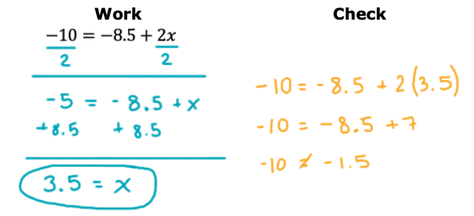
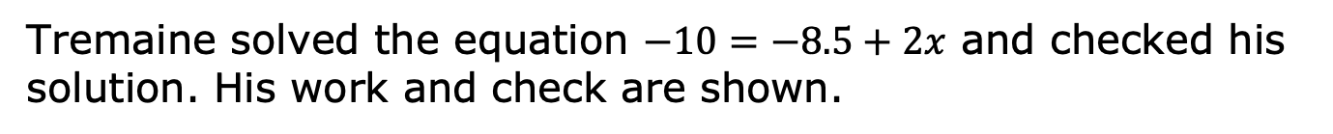
1.6.1 Warm-Up: Bell Work
Tremaine solved the equation $−10=−8.5+2x$ and checked his solution. His work and check are shown.
volume 1, pg. 37

Slide 7
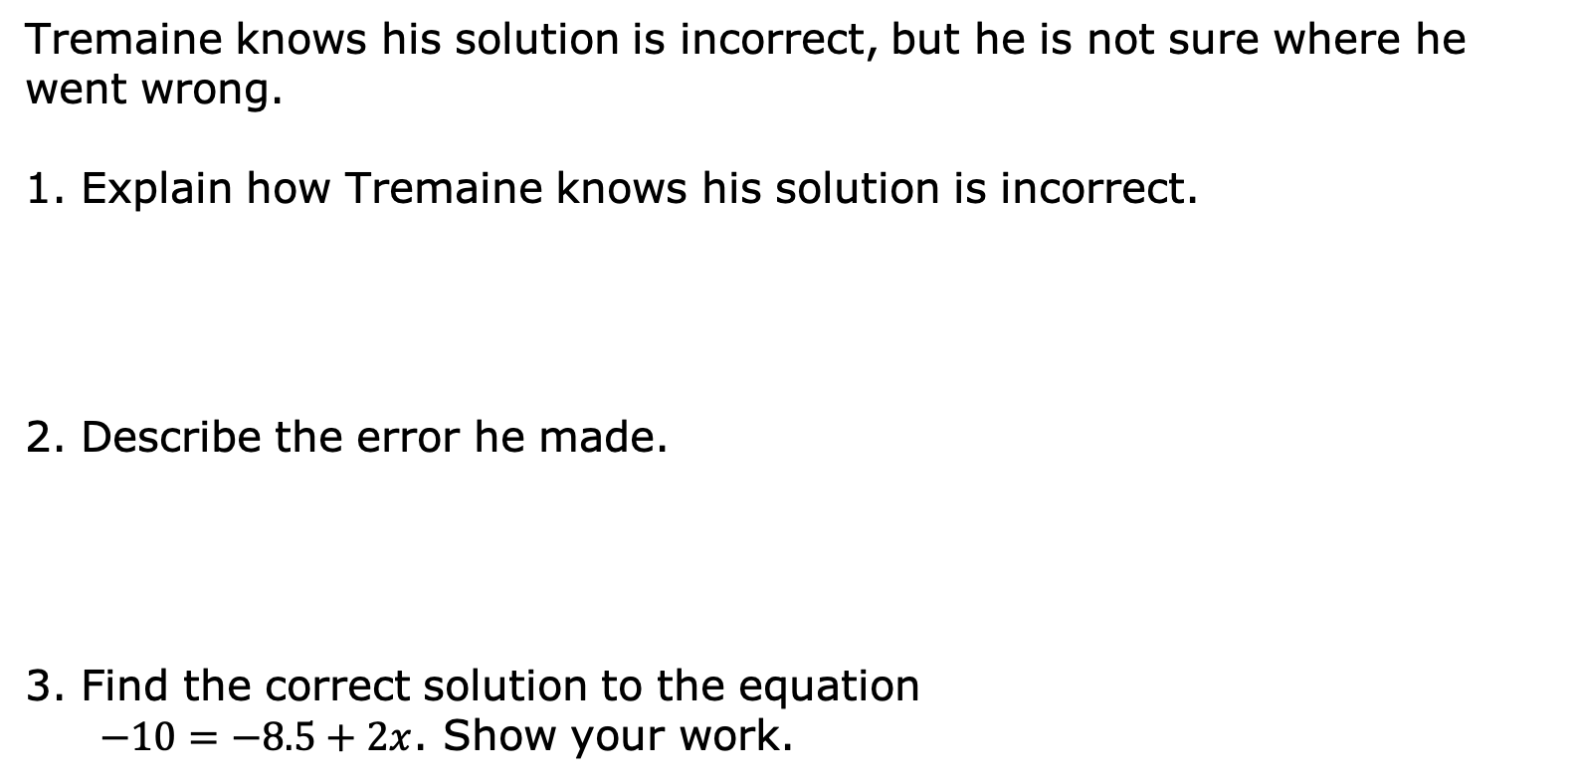
Tremaine knows his solution is incorrect, but he is not sure where he went wrong.
1. Explain how Tremaine knows his solution is incorrect.
2. Describe the error he made.
3. Find the correct solution to the equation
$−10=−8.5+2x$. Show your work.
volume 1, pg. 37

Slide 8

Guided Instruction
volume 1, pg. 37

Slide 9
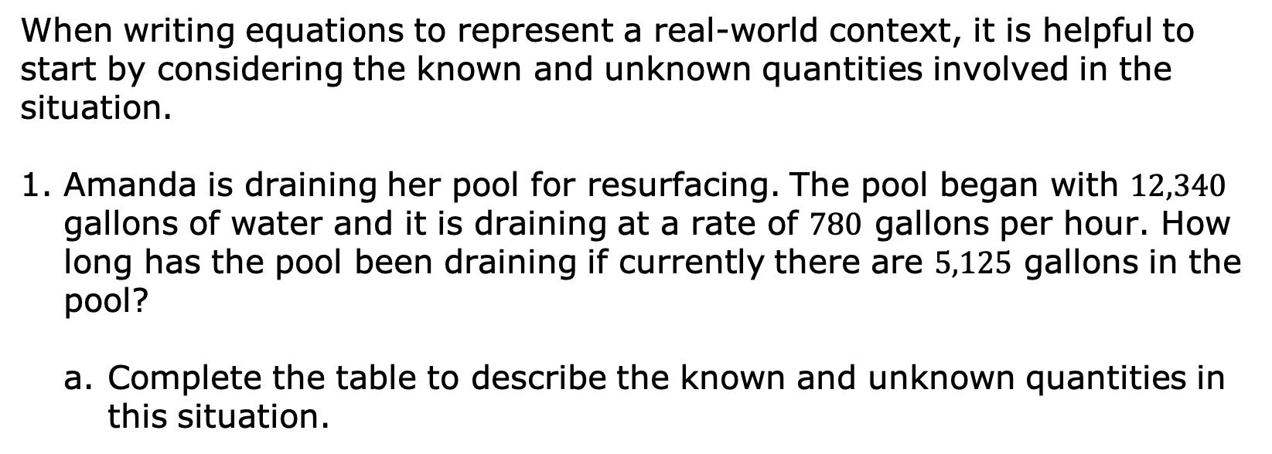
1.6.2 Guided Instruction: Writing Two-Step Equations From Real-World Contexts
When writing equations to represent a real-world context, it is helpful to start by considering the known and unknown quantities involved in the situation.
Amanda is draining her pool for resurfacing. The pool began with $12,340$ gallons of water and it is draining at a rate of $780$ gallons per hour. How long has the pool been draining if currently there are $5,125$ gallons in the pool?
Complete the table to describe the known and unknown quantities in this situation.
Known Quantities | Unknown Quantities
volume 1, pg. 37

Slide 10

b. With your partner, discuss how the quantities are related in this situation.
c. Define the unknown quantity using a variable.
d. Write an equation that could be used to find the unknown quantity using the variable you defined.
e. Solve the equation.
When writing equations to represent real-world contexts, any variables used must be defined to identify which quantity each variable in the equation represents.
volume 1, pg. 37

Slide 11
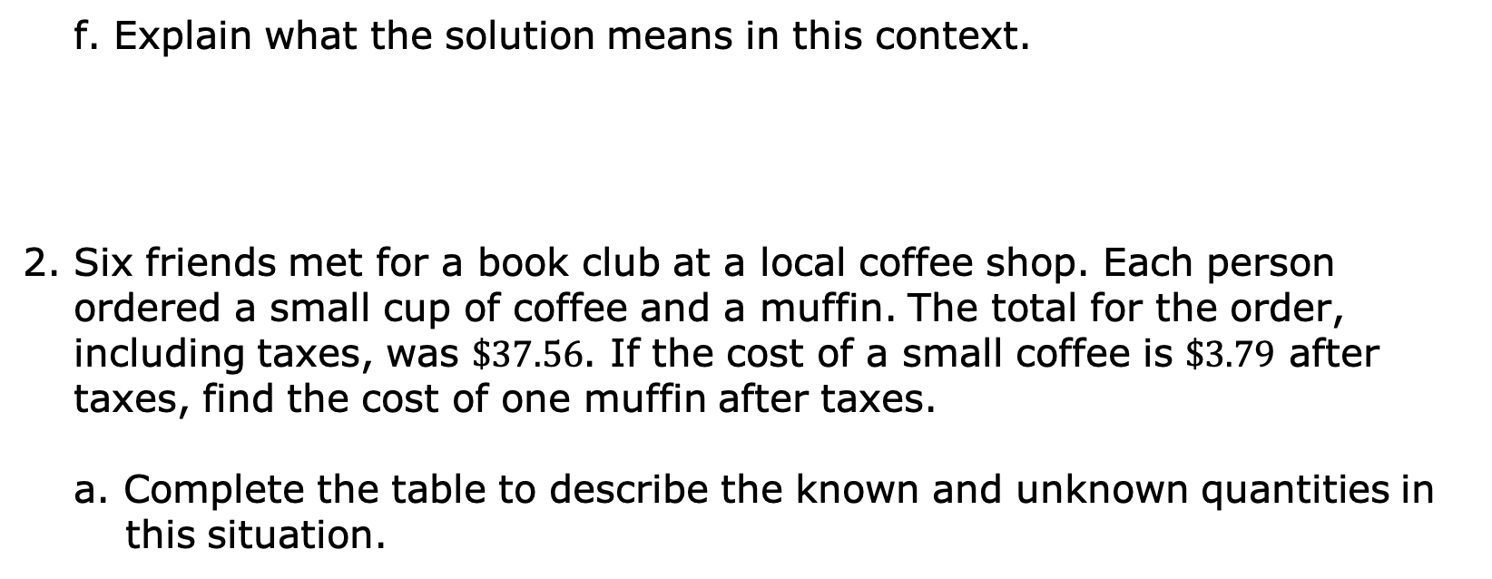
f. Explain what the solution means in this context.
2. Six friends met for a book club at a local coffee shop. Each person ordered a small cup of coffee and a muffin. The total for the order, including taxes, was $\$37.56$. If the cost of a small coffee is $\$3.79$ after taxes, find the cost of one muffin after taxes.
a. Complete the table to describe the known and unknown quantities in this situation.
Known Quantities | Unknown Quantities
volume 1, pg. 38

Slide 12
b. Define the unknown quantity using a variable.
c. Write an equation that could be used to find the unknown quantity using the variable defined.
d. Solve the equation.
e. Explain what the solution means in this context.
volume 1, pg. 38

Slide 13

Try It
volume 1, pg. 39

Slide 14

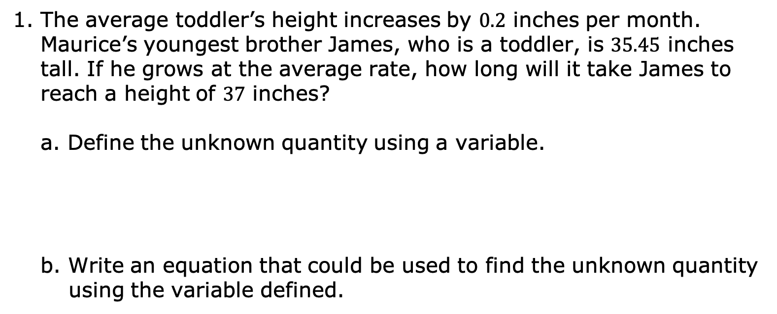
1.6.3 Try It: Writing Two-Step Equations From Real-World Contexts
The average toddler’s height increases by $0.2$ inches per month. Maurice’s youngest brother James, who is a toddler, is $35.45$ inches tall. If he grows at the average rate, how long will it take James to reach a height of $37$ inches?
Define the unknown quantity using a variable.
b. Write an equation that could be used to find the unknown quantity using the variable defined.
volume 1, pg. 39

Slide 15
c. Solve the equation.
d. Explain what the solution means in this context.
volume 1, pg. 39

Slide 16

Guided Practice
volume 1, pg. 40

Slide 17

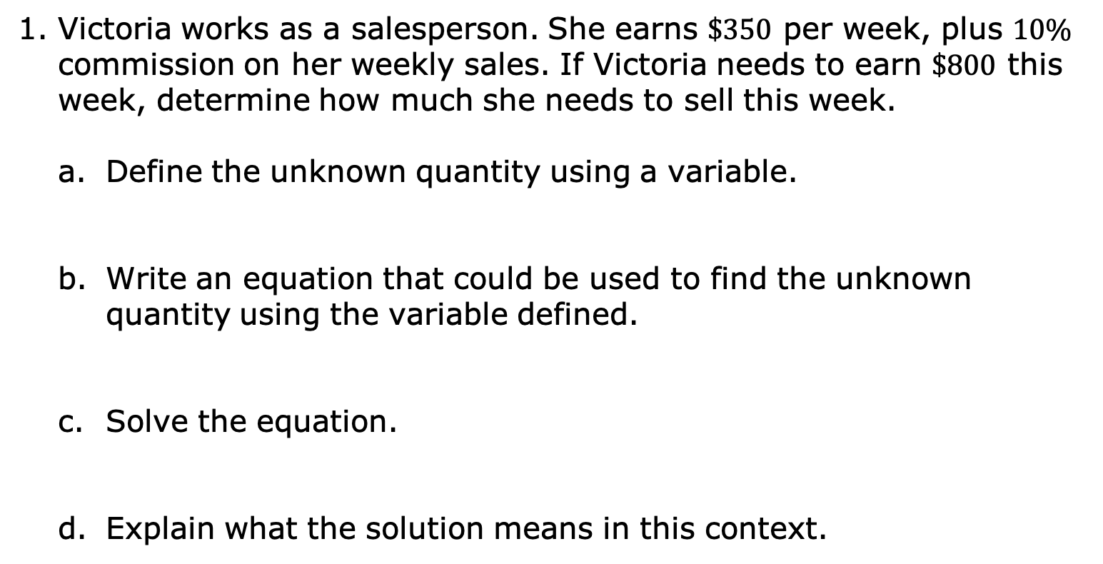
1.6.4 Guided Practice: Writing Two-Step Equations From Real-World Contexts Involving Percentages
Victoria works as a salesperson. She earns $\$350$ per week, plus $10\%$ commission on her weekly sales. If Victoria needs to earn $\$800$ this week, determine how much she needs to sell this week.
Define the unknown quantity using a variable.
Write an equation that could be used to find the unknown quantity using the variable defined.
Solve the equation.
Explain what the solution means in this context.
volume 1, pg. 40

Slide 18
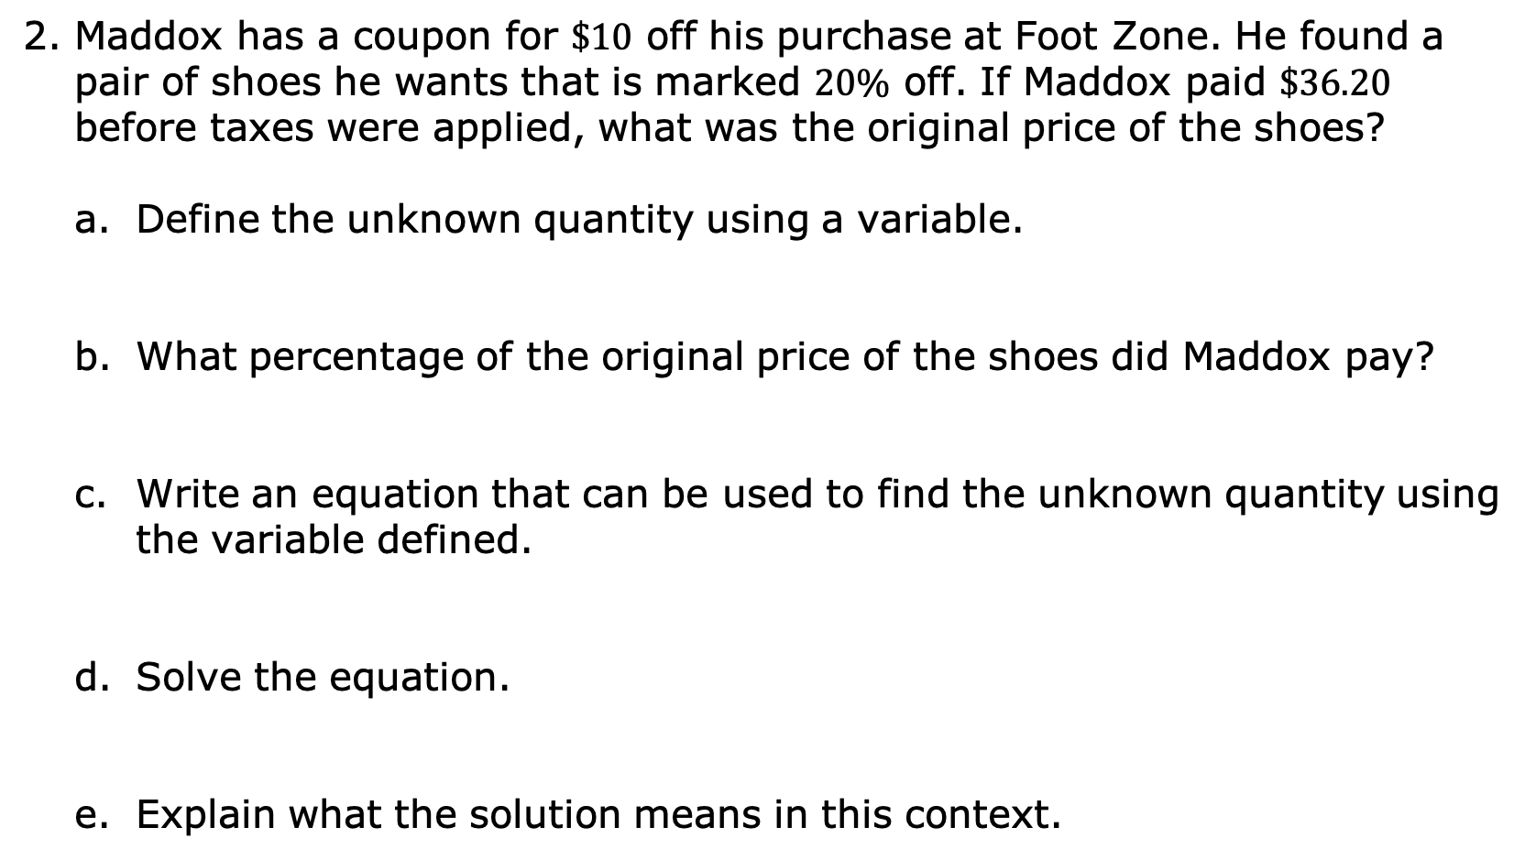
2. Maddox has a coupon for $\$10$ off his purchase at Foot Zone. He found a pair of shoes he wants that is marked $20\%$ off. If Maddox paid $\$36.20$ before taxes were applied, what was the original price of the shoes?
Define the unknown quantity using a variable.
What percentage of the original price of the shoes did Maddox pay?
Write an equation that can be used to find the unknown quantity using the variable defined.
Solve the equation.
Explain what the solution means in this context.
volume 1, pg. 40

Slide 19

Wrap-Up
volume 1, pg. 41

Slide 20
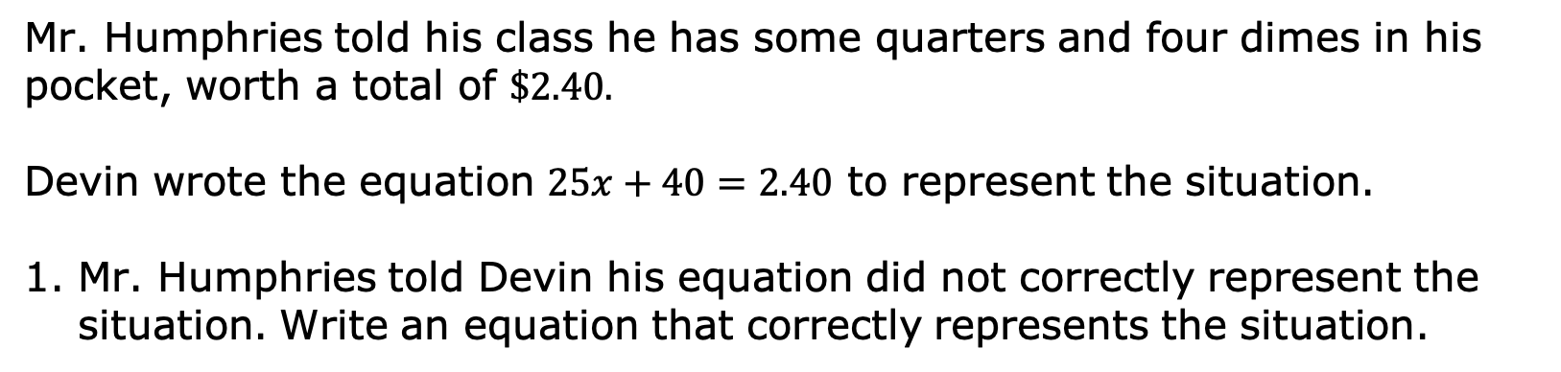
1.6.5 Wrap-Up: Error Analysis
Mr. Humphries told his class he has some quarters and four dimes in his pocket, worth a total of $\$2.40.$
Devin wrote the equation $25x+40=2.40$ to represent the situation.
Mr. Humphries told Devin his equation did not correctly represent the situation. Write an equation that correctly represents the situation.
volume 1, pg. 41

